Slide 2


Analysis of FPAs in the LHC RB circuit
Christoph Obermair, TE-MPE-CB Lukas Felsberger, TE-MPE-MI Franz Pernkopf, TU-Graz Andrea Apollonio, TE-MPE-CB Daniel Wollmann, TE-MPE-CB

Slide 3
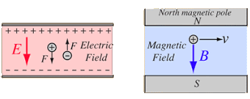
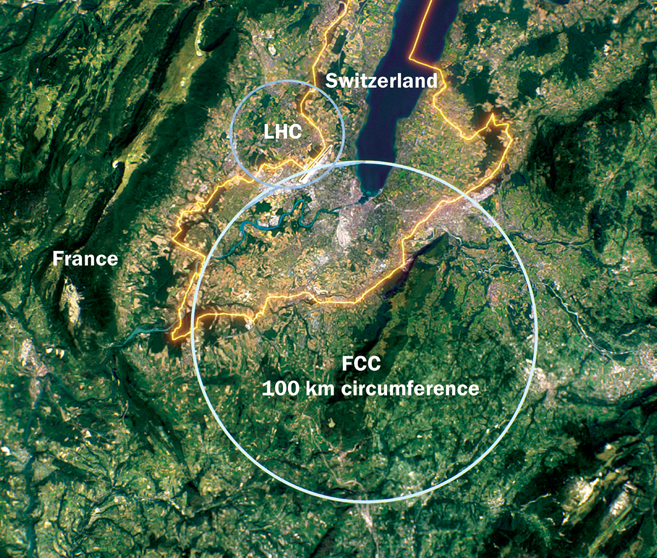
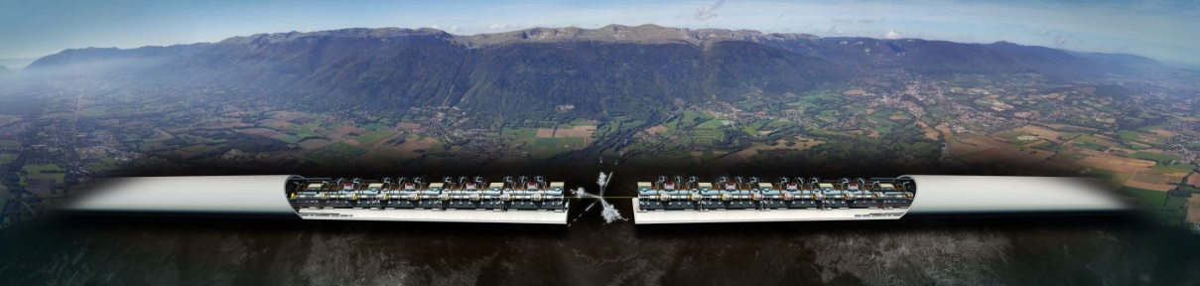
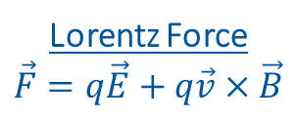
Introduction to Accelerators
Principle: Accelerate particles with electric field, and analyze collissions with target.
Types:
Linear accelerators - Linear accelerator 4 (Linac4)
Limitation to high collission energy is electric field
Breakdowns can destry radio frequency cavities
Circular accelerators - Large Hadron Collider (LHC)
Limitation to high collission energy is electric field
Quenches can destroy magnets
Current LHC status: LHC page 1
Lorentz Force
$$\vec{F}=q\vec{E}+q\vec{v}×\vec{B}$$
CLIC concept image

Slide 4
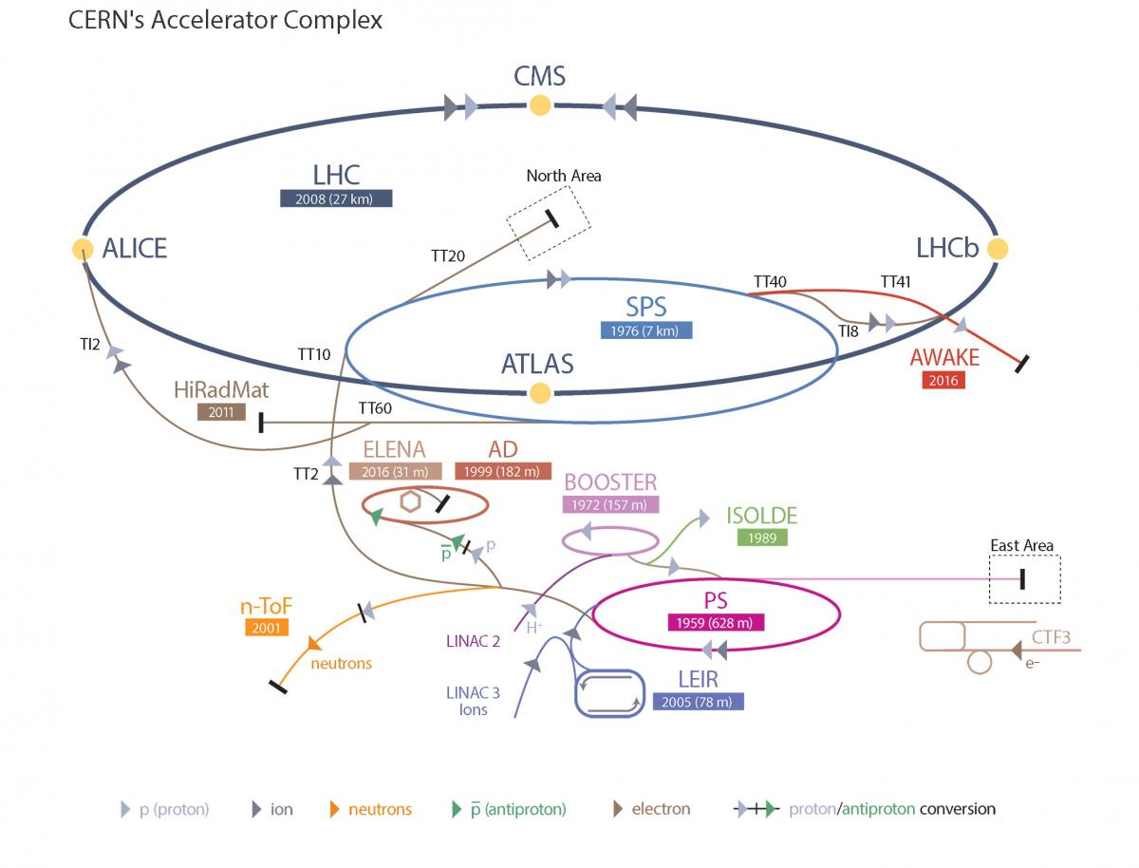
Large Hadron Collider - LHC
LHC Facts
Cost of the LHC | 4332 MCHF
Length | 26 659 m
Dipole operating temperature | -271.3°C
Cost per magnet | ~ 1 MCHF
Number of main dipoles | 1232
Power consumtion | 1.3 TWh/a
Number of circuits | 8
Stored energy per circuit | 1.1 GJ (380-ton TGV @ 50km/h)
12/14/2022

Slide 5
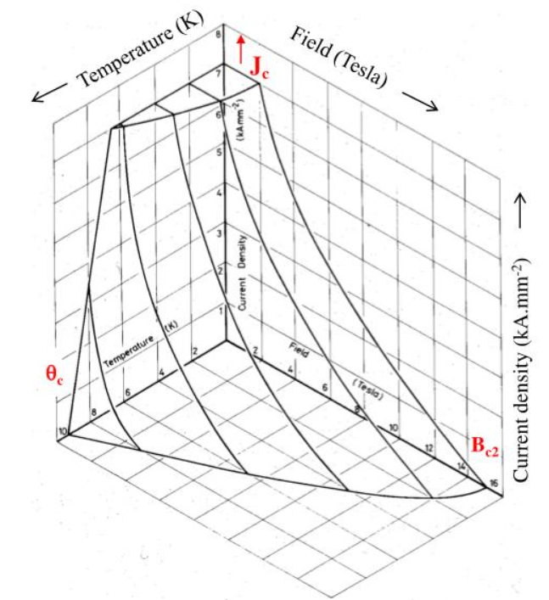
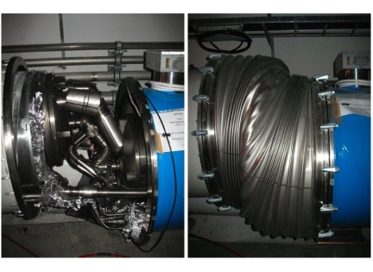
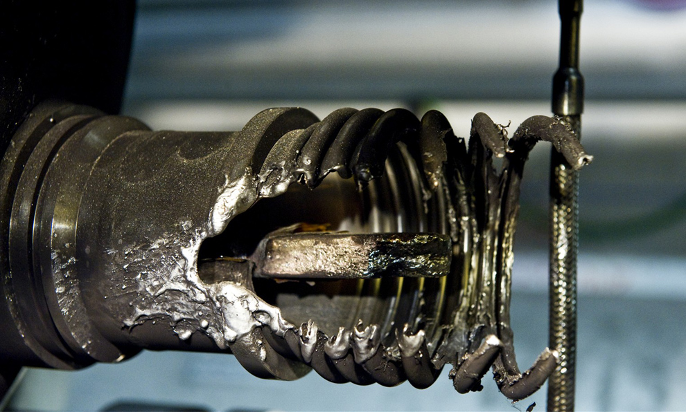
Quench Protection
Quench is biggest threat to LHC dipole magnets
Different types of quench:
Primary quench
Secondary quench: GHe propagation, EM disturbance,..
Quench Protection:
Bypass Diode
Quench Heater
Quenches with destructed magnets:
2008 (~100 destroyed magnets – splice opened)
2021 HWC (1 destroyed magnet - interturn short in coil)
Possible precursor detected 1 month before
Precursor: Oscillation in U_Diode Voltage
Goal: Further precursors?
Critical surface NbTi

Slide 6
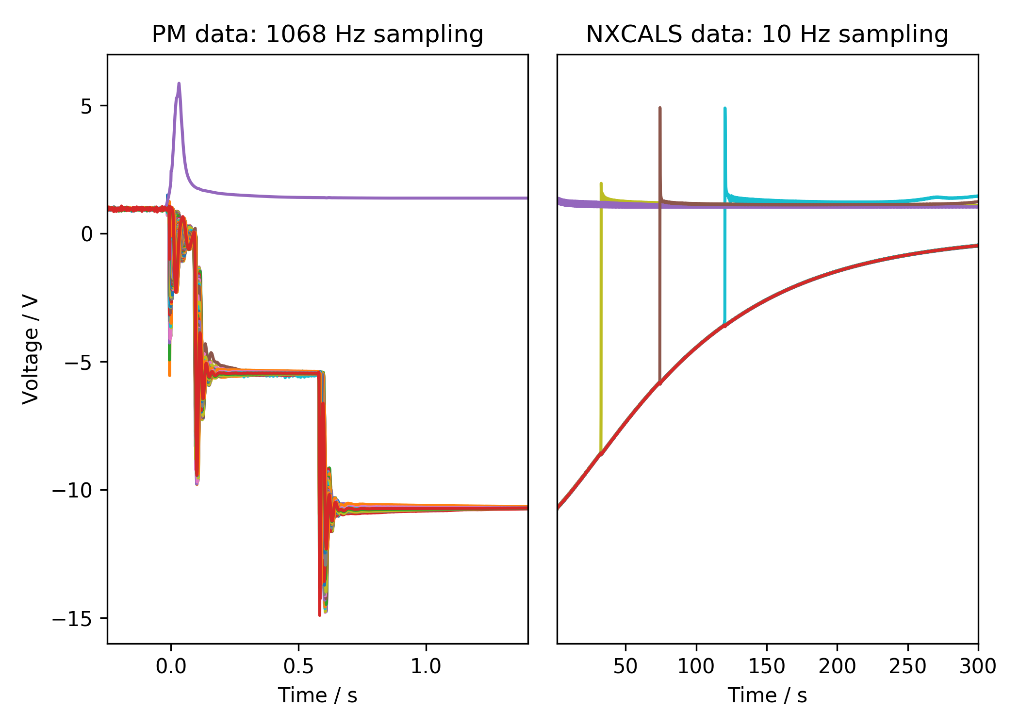
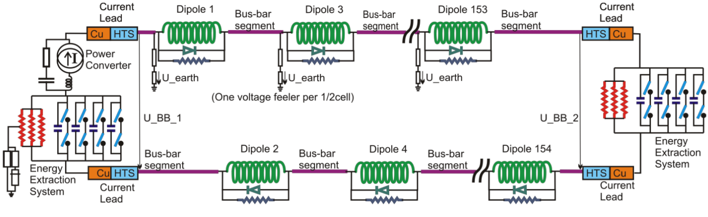
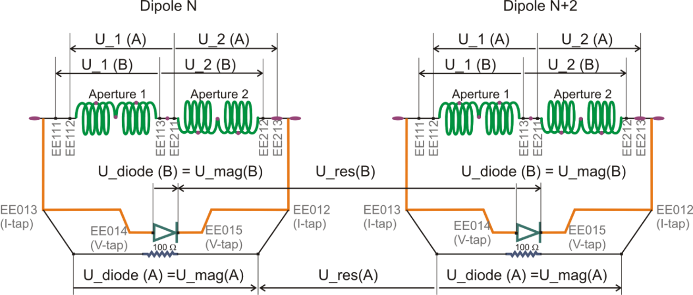
Quench Protection: U-Diode
Analyzed Area
Analyzed Area
2nd EE switch off
Secondary quench
1st EE switch off
PC Switch off

Slide 7
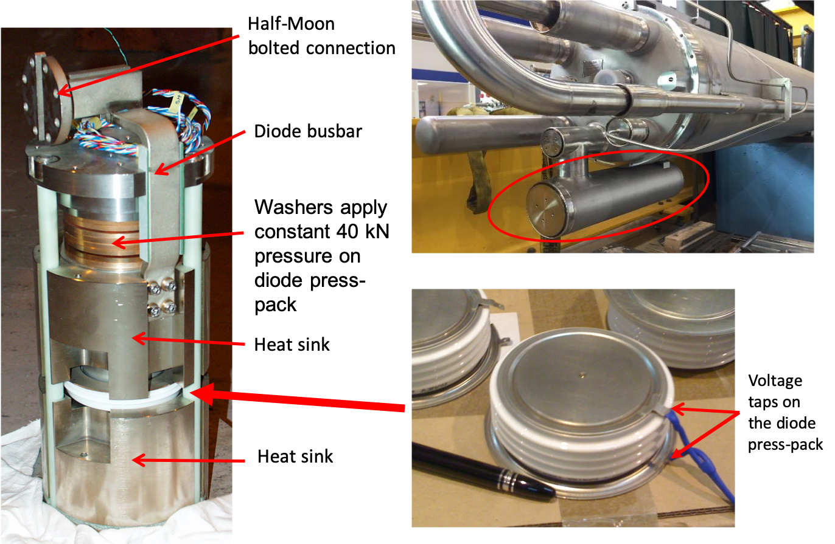
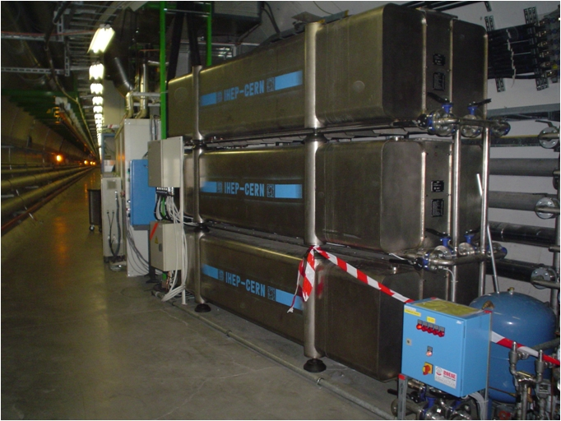
Hardware
Diode
Energy Extraction Resistance

Slide 8
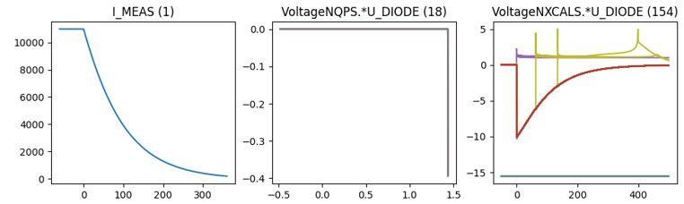
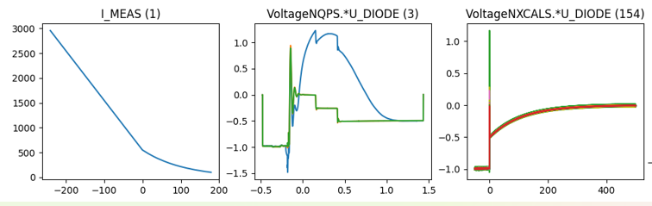
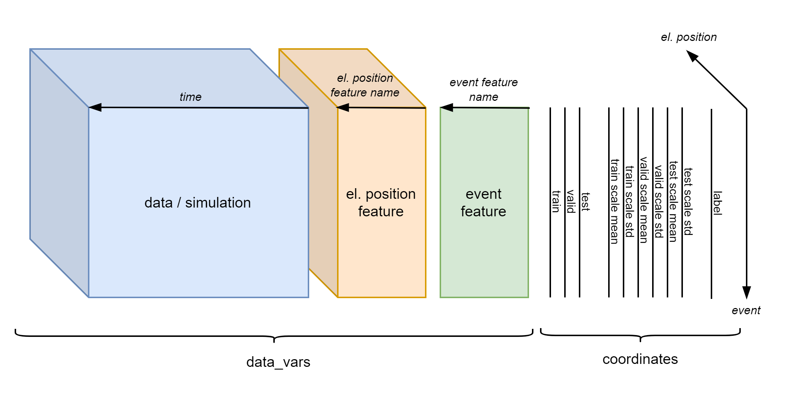
Existing Database Overview
Data overview
Filtered events
 | Signal | 2014-2020 | 2021 | # events
Real Data | U_DIODE_NXCALS | P | P | 867
 | U_DIODE_PM | P | P | 629
 | I_MEAS | P | P | 896
 | U_QSO, U_1, U_2 | P | P | 893
 | I_EARTH_PCNT | P | P | 895
 | I_EARTH | P | P | 629
 | I_HDS, U_HDS | P | P | 896
 | EEUDumpResPM | P | P | 896
Simulations | V(0v_magf*) | P | P | 875
 | I(r1_warm) | P | P | 875
 | V(10,11), V(18,19) | P | P | 875
#events |  | 267 | 629 | 560/896

Slide 9
What are the expected oscillations after a quench?

Slide 10
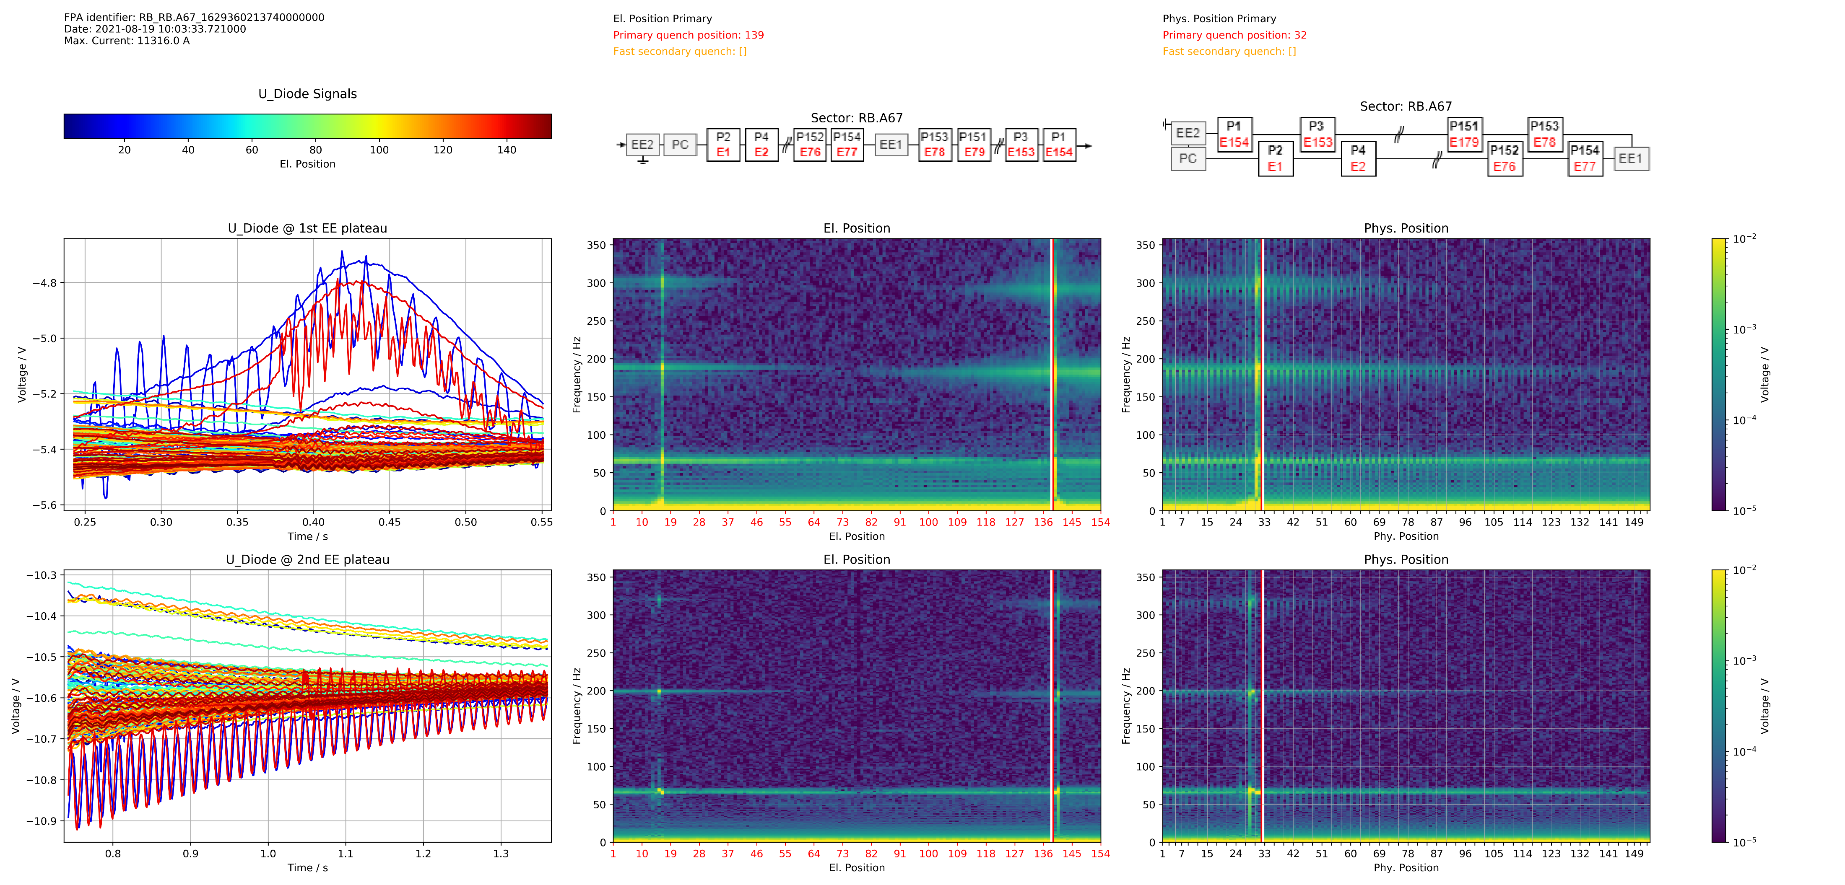
Position Frequency (FP) Map

Slide 11
Sort Magnets differently

Slide 12
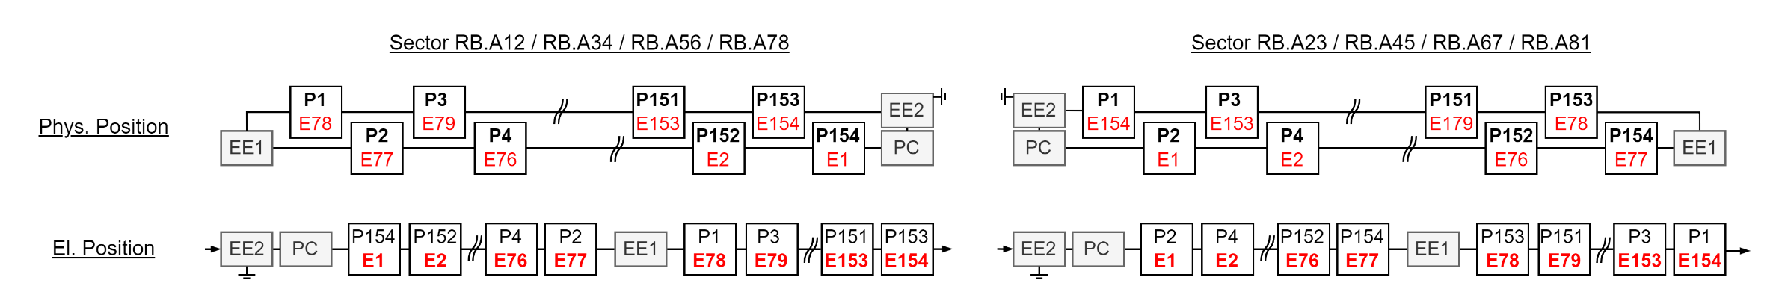
El. Vs Phys. Position

Slide 13
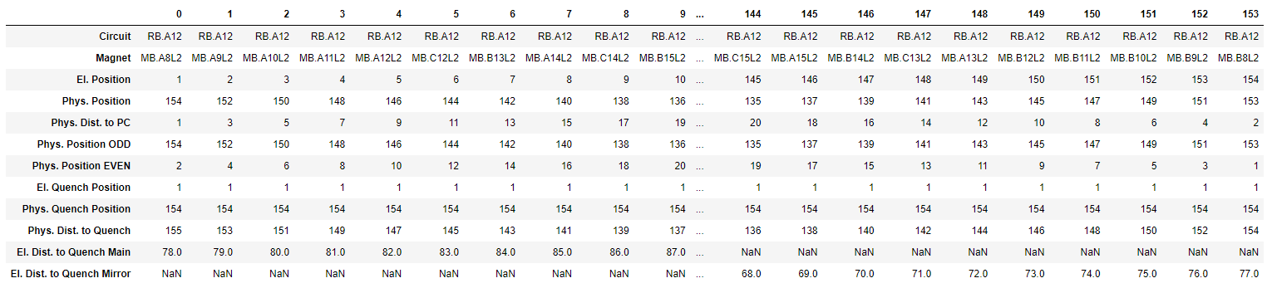
ODD: El. Vs Phys. Position Table

Slide 14
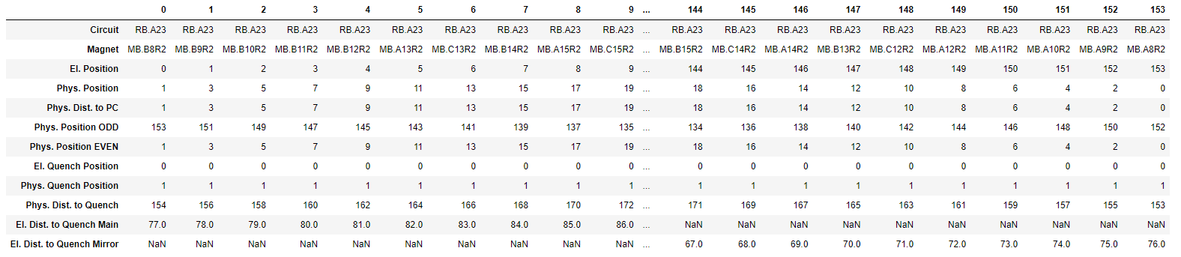
EVEN

Slide 15
How are the FP-maps composed?

Slide 16
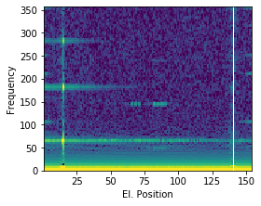
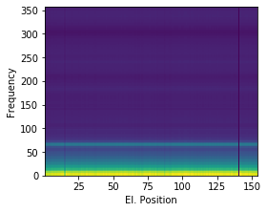
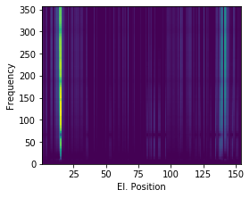
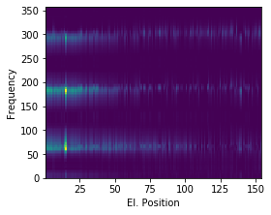
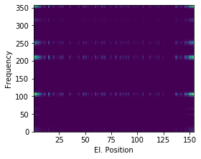
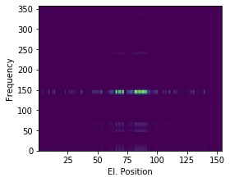





How are the FP-maps composed?
$$≈$$
$$+$$
$$+$$
$$+$$
$$+$$
Common Oscillation
Physical Propagation
Electrical Propagation
Power Converter
Energy Extraction
Event:
RB_RB.A78_1617170255140000000
2021-03-31 07:57:35.120000

Slide 17
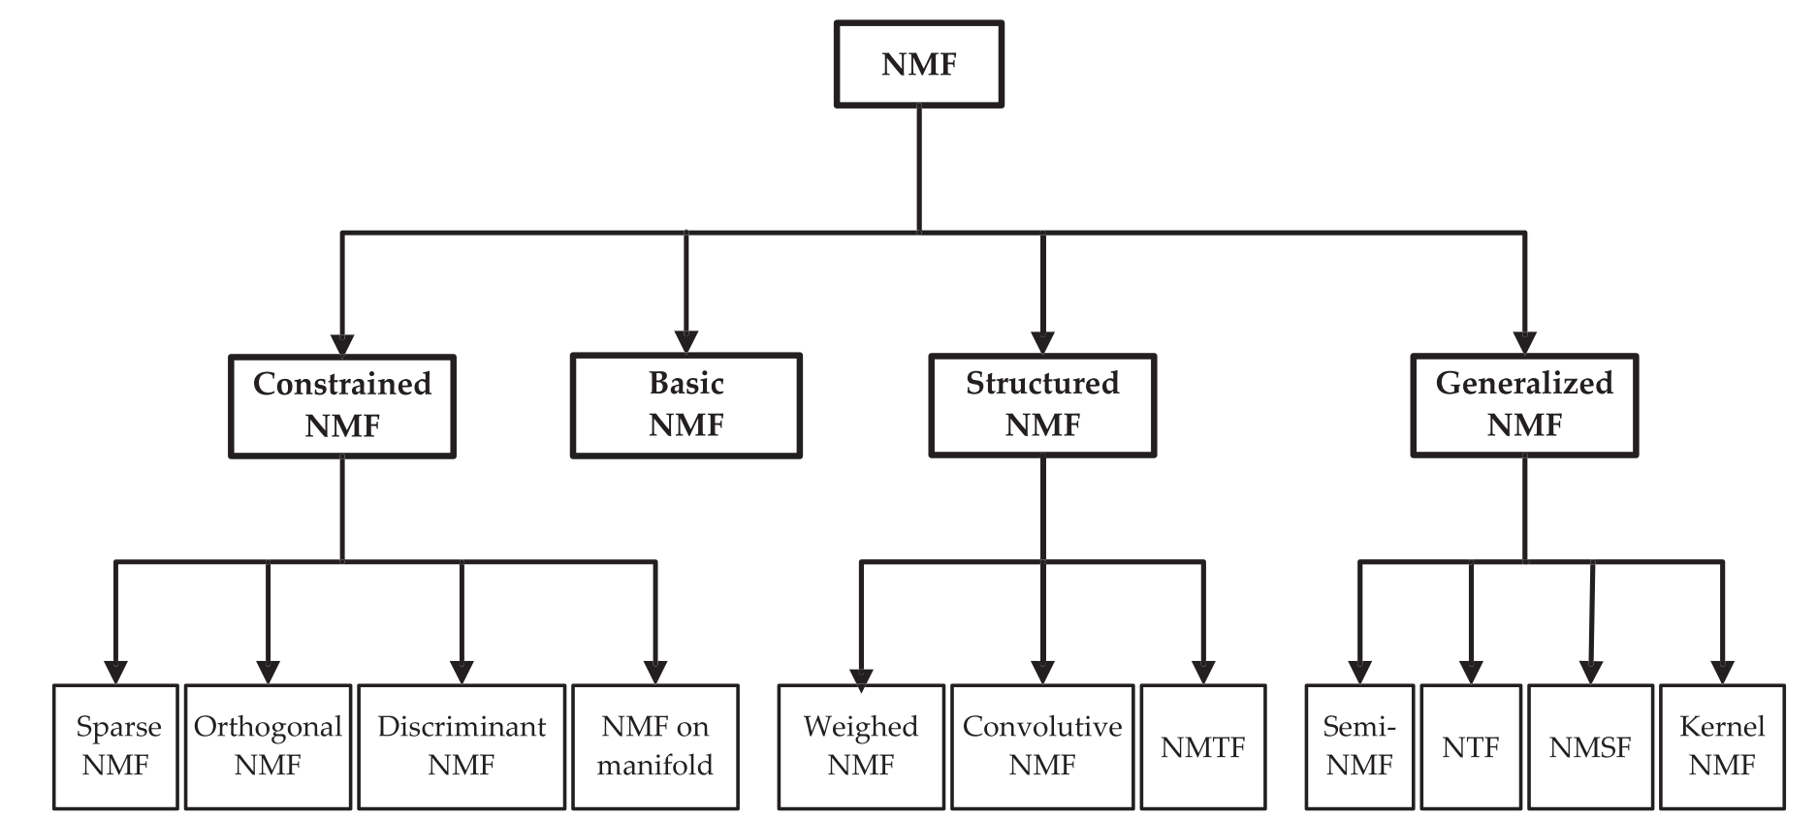
Non-Negative Matrix Factorization

Slide 18
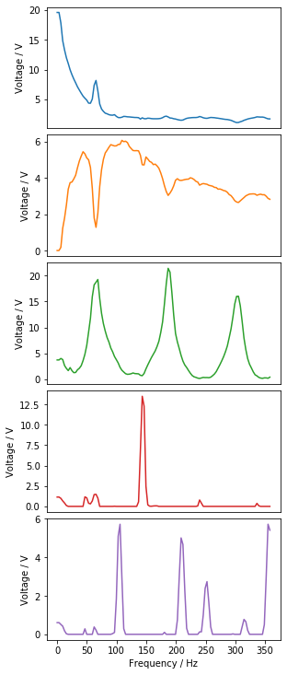
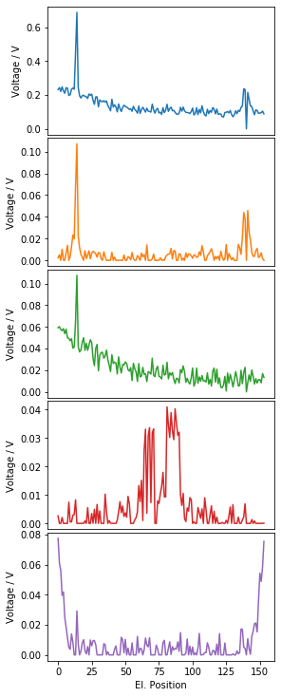
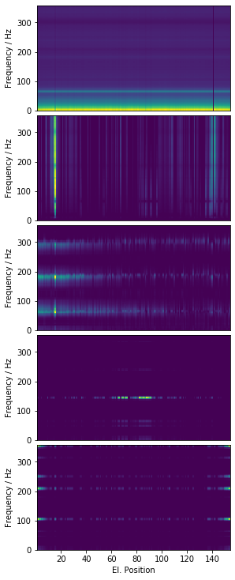
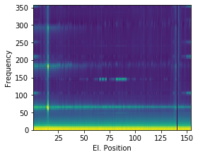
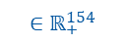
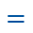
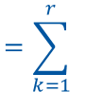
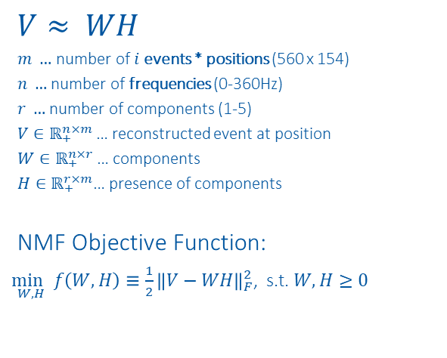
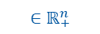
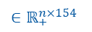
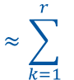
NMF on Position Frequency Maps
$$V≈ WH$$
$m …$ number of $i$events * positions (560 x 154)
$n …$ number of frequencies (0-360Hz)
$r …$ number of components (1-5)
$V∈ℝ_{+}^{n×m}$… reconstructed event at position
$W∈ℝ_{+}^{n×r}$… components
$H∈ℝ_{+}^{r×m}$… presence of components
NMF Objective Function:
$\underset{W,H}{\min{ }}f\left(W, H\right)≡\frac{1}{2}{\left\|V−WH\right\|}_{F}^{2}$, s.t. $W, H≥0$
$$V_{:,i:i+154} ≈ \sum_{k=1}^{r}{{ W}_{:,k}{ H}_{k,i:i+154} =}\sum_{k=1}^{r}{{ WH}_{k, i:i+154} = {WH}_{i:i+154}}$$
$${∈ℝ}_{+}^{n×154}$$
$${ ∈ℝ}_{+}^{n}$$
$${ ∈ℝ}_{+}^{154}$$
$${∈ℝ}_{+}^{n×154}$$
$${∈ℝ}_{+}^{n×154}$$
$$≈\sum_{k=1}^{r}{ }$$
$$⋅$$
$$=\sum_{k=1}^{r}{ }$$
$$=$$
$$⋅$$
$$⋅$$
$$⋅$$
$$⋅$$
https://www.nature.com/articles/44565
https://proceedings.neurips.cc/paper/2000/file/f9d1152547c0bde01830b7e8bd60024c-Paper.pdf

Slide 19
2021-03-31 07:57:35.120000

Slide 20
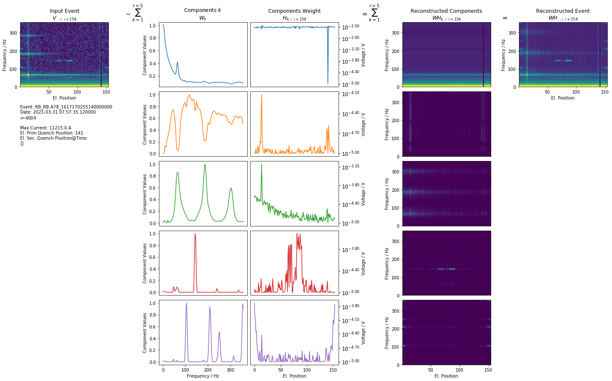
1st EE 2021-03-31 07:57:35.120000

Slide 21
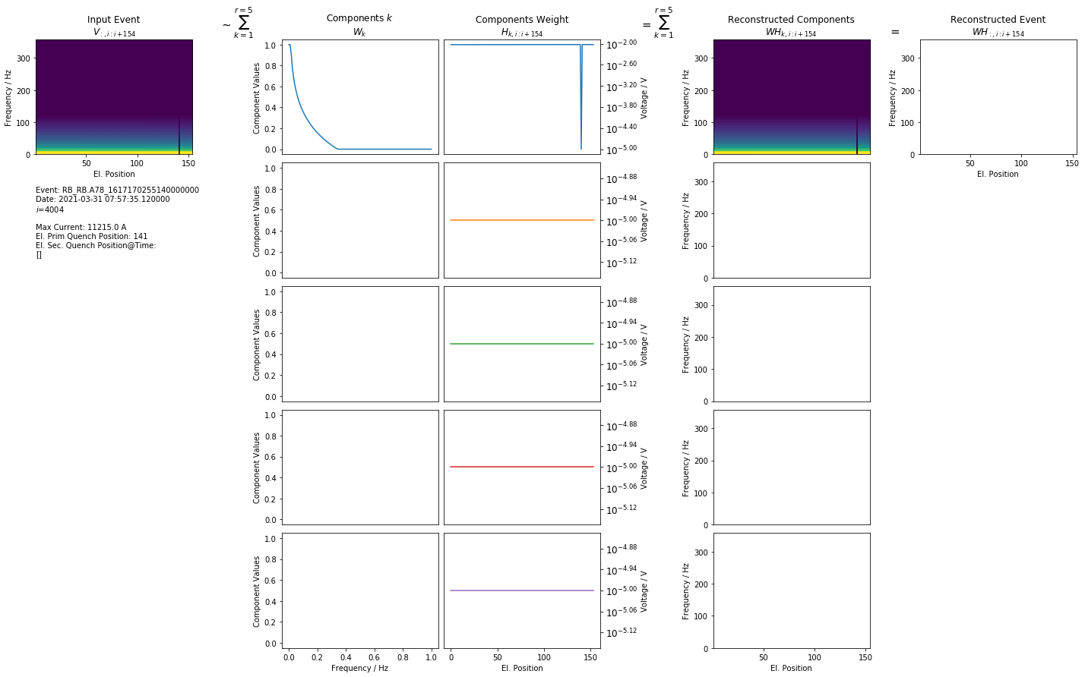
Simulation 1st EE 2021-03-31 07:57:35.12

Slide 22
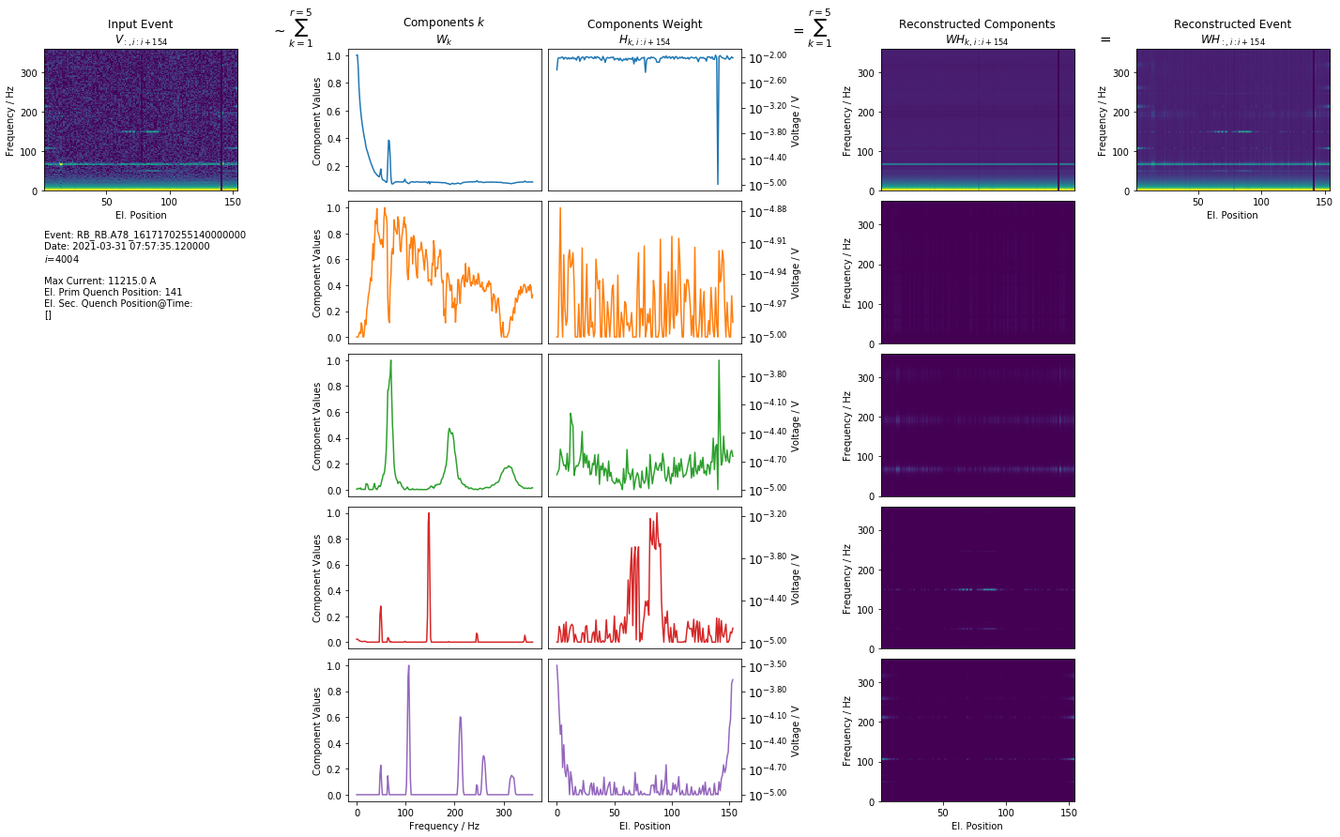
2nd EE 2021-03-31 07:57:35.120000

Slide 23
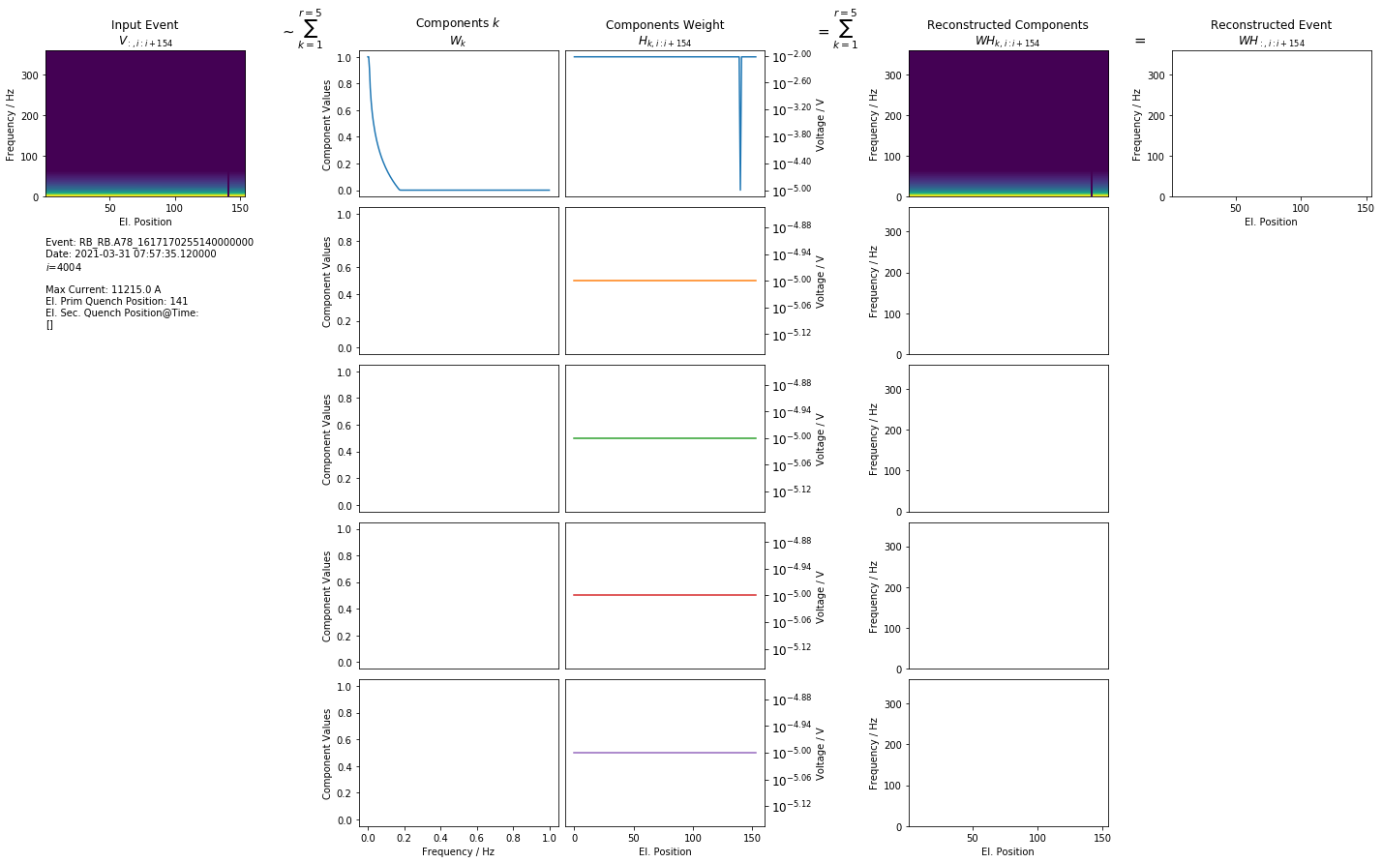
Simulation 2nd EE 2021-03-31 07:57:35.12

Slide 24
1st EE Component Generalization

Slide 25
1st EE: Average Weight of Component 0
$→$ Frequency propagates along axis with lowest $SNR$ ($SNR=\frac{μ}{σ}$)

Slide 26
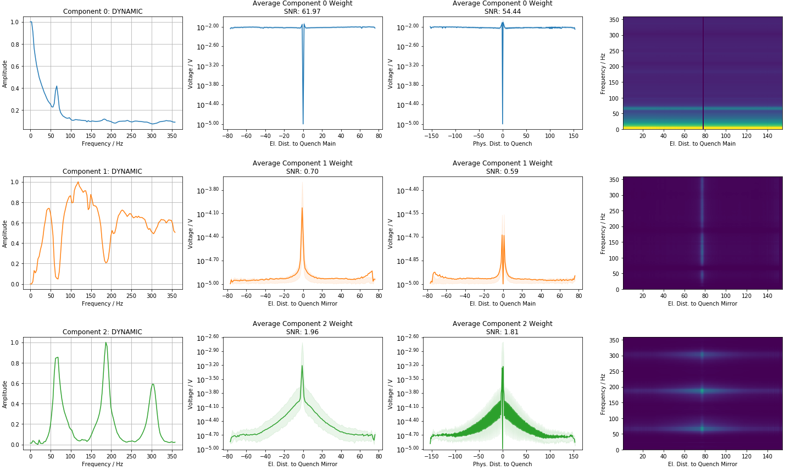
1st EE: Average Weight of Components

Slide 27
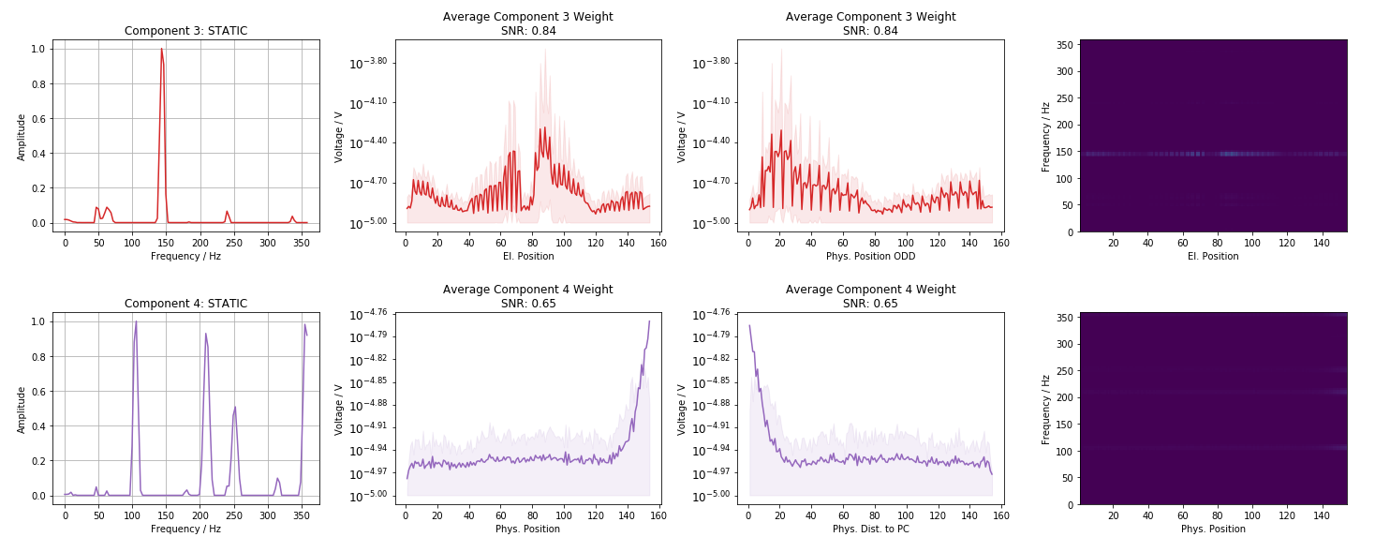
1st EE: Average Weight of Components

Slide 28
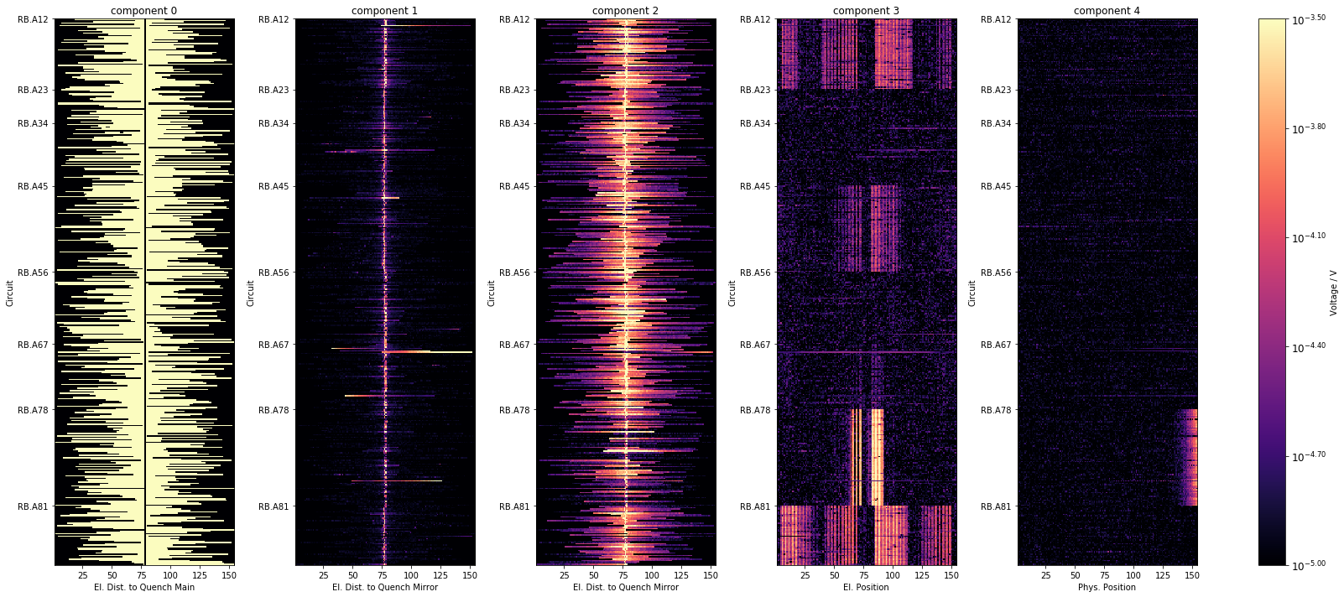
1st EE: Component distribution over Sector
All events from 2021, excl. events with fast sec. quenches

Slide 29
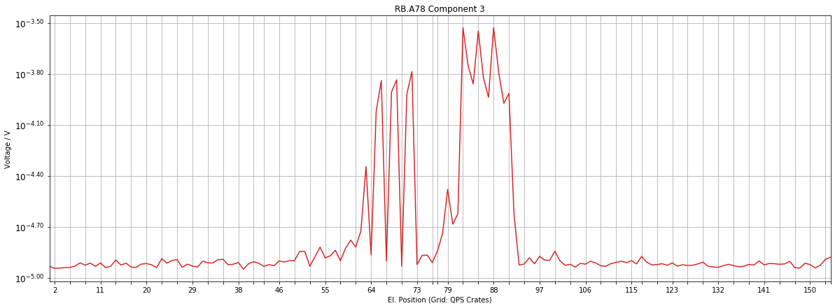
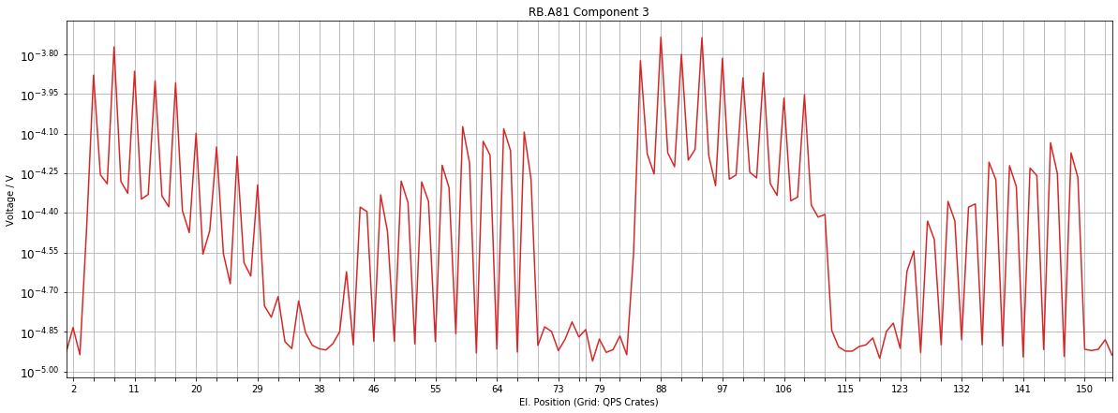
1st EE: Component 3: QPS Crate Grid

Slide 30
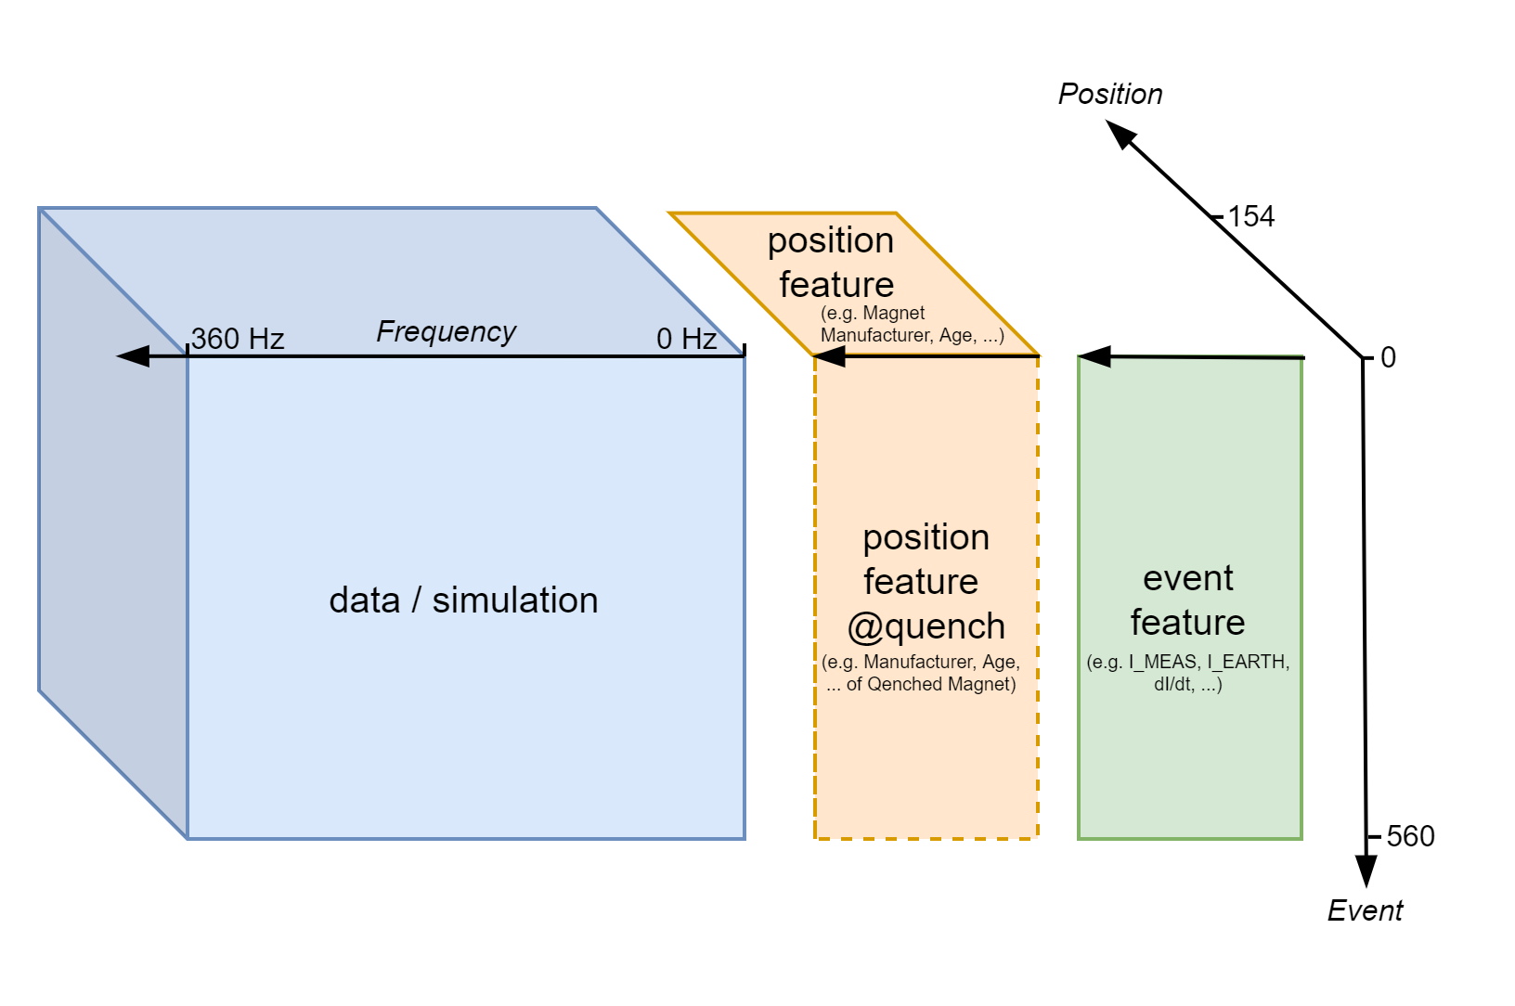
1st EE Correlation

Slide 31
Correlation - Event Features

Slide 32
Correlation - Position Features

Slide 33
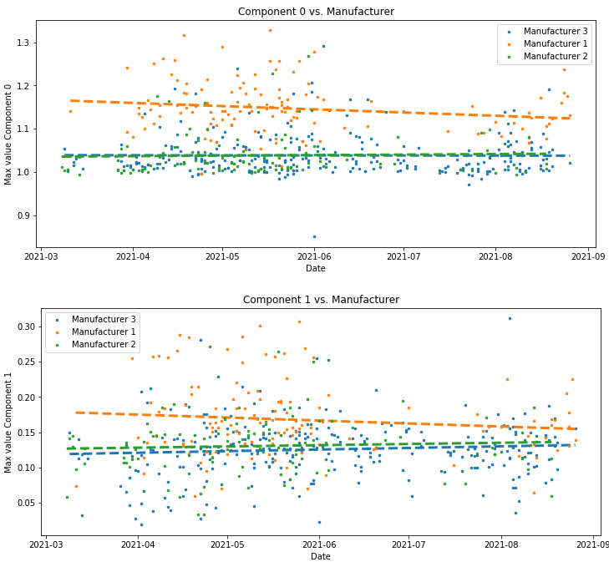
Plot features with high correlation

Slide 34
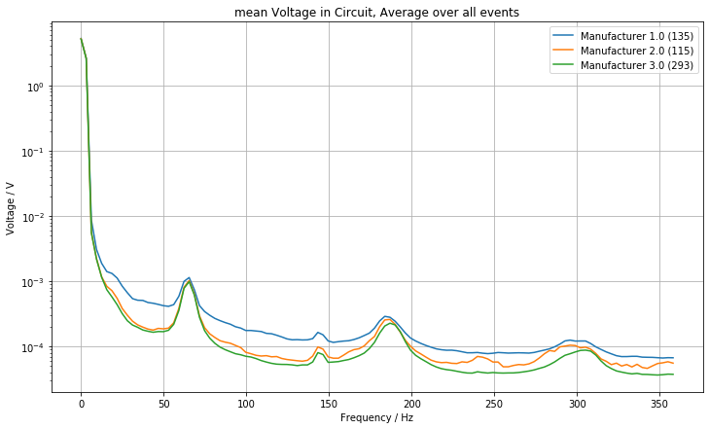

Plot features with high correlation

Slide 35

Plot features with high correlation

Slide 36

Plot features with high correlation

Slide 37

Plot features with high correlation

Slide 38




Plot features with high correlation

Slide 39
1st EE Component Correlation

Slide 40

Plot features with high correlation

Slide 41

Plot features with high correlation

Slide 42

Plot features with high correlation

Slide 43

Energy component 2

Slide 44
2nd EE: Component Generalization

Slide 45

2nd EE: Average Weight of Components

Slide 46

2nd EE: Average Weight of Components

Slide 47

2nd EE: Component distribution over Sector
All events from 2021, excl. events with fast sec. quenches

Slide 48

Recreate Events

Slide 49
Snapshots

Slide 50

Snapshots: 1st EE 2022-03-11 17:02:12

Slide 51

Snapshots 1st EE: Distribution over Sector
47/64 events successfully downloaded.

Slide 52

Snapshots 1st EE: Distribution over Current
47/64 events successfully downloaded.

Slide 53

Snapshots: 2nd EE 2022-03-11 17:02:12

Slide 54

Snapshots 2nd EE: Distribution over Sector
47/64 events successfully downloaded.

Slide 55

Snapshots 2nd EE: Distribution over Current
47/64 events successfully downloaded.

Slide 56

Next Steps
Find normal components -> optimize regularization + hyperparameters for NMF
Improve NMF:
Split in trainable non-trainable components
Sanity Check:
Check NMF components Snapshots
Component distribution:
Distribution over sector, sec. quench type (training, QH trigger), time, intercoil short sector
Isolate normal NMF components:
Which el. components are causing them
Fix normal NMF components (no update in $W$)-> Find anomaly component:
Which component occurs in faulty magnets
How does component weight change over time

Slide 58
Further NMF examples

Slide 59

RB.A23 2021-03-09 07:39:33

Slide 60

1st EE RB.A23 2021-03-09 07:39:33

Slide 61

2nd EE RB.A23 2021-03-09 07:39:33

Slide 62








NMF Examples
$$≈\sum_{k=1}^{r}{ }$$
$$⋅$$
$$=\sum_{k=1}^{r}{ }$$
$$=$$
$$⋅$$
$$⋅$$
$$⋅$$
$$⋅$$

Slide 63





NMF Examples
$$≈\sum_{k=1}^{r}{ }$$
$$⋅$$
$$=\sum_{k=1}^{r}{ }$$
$$=$$
$$⋅$$
$$⋅$$
$$⋅$$
$$⋅$$

Slide 64
Sanity Checks

Slide 65




Kirchhoff
$$−U_{BB_{1}}+U_{BB_{2}}+\sum_{n=1}^{154}{U_{Diode}\left(n\right)}=0$$
Challenges: (1) Sampling (2) Time-alignment

Slide 66


FFT sanity check

Slide 67

Data - Simulation

Slide 68
Special Events

Slide 69
Intercoil Short

Slide 70

Intercoil Precursor

Slide 71

Diode Short

